Slide 1
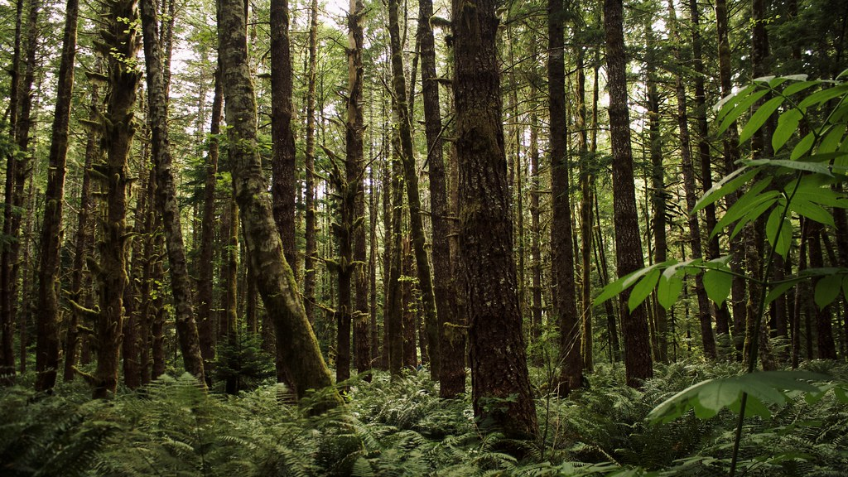
Anti-Spray for Wildfires: A Data-Driven Solution for British Columbia

Slide 2

MU Inc. WILDFIRE DEFENSE TEAM
Diego Cortes Silva
King Camota
Swikriti Neupane
Vishnupriya Kamalon

Slide 3
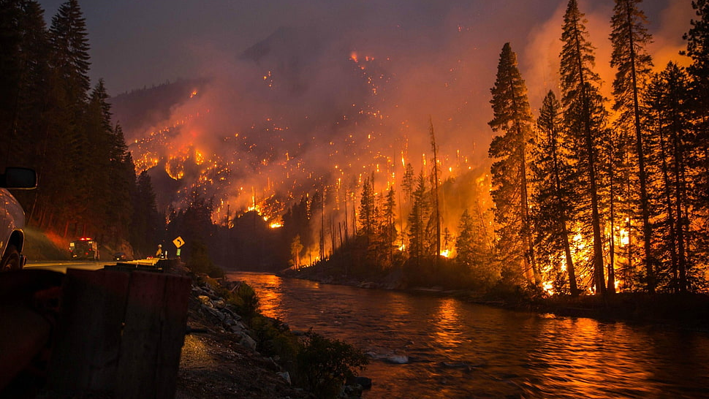
How does this image make you feel about the impact of wildfires?
https://www.wallpaperflare.com/forest-fire-photo-fire-forest-wallpaper-245327

Slide 4
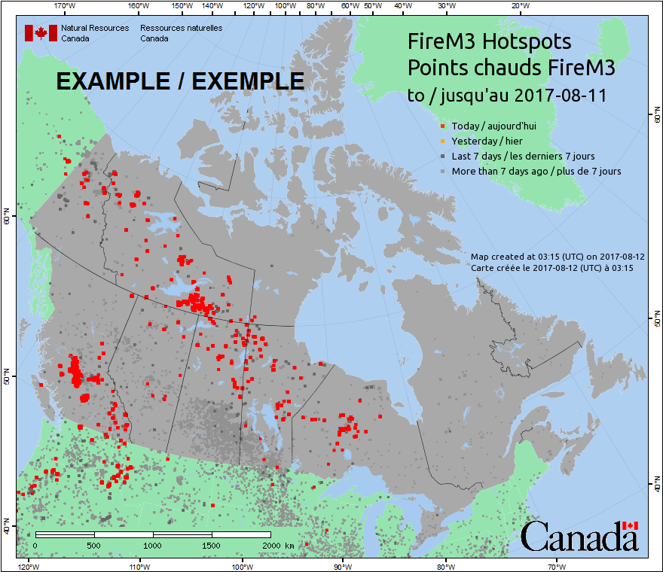
The Problem – BC Wildfire Crisis
According to CWFIS,
1.4 million wildfires over the past 10 years

Slide 5
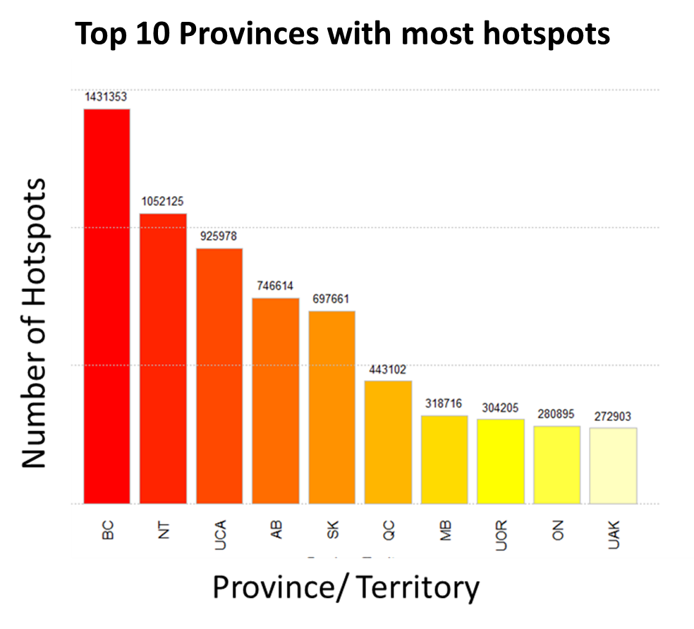
Wildfire Prevalence in British Columbia
BC - Province with the highest wildfire occurrences

Slide 6
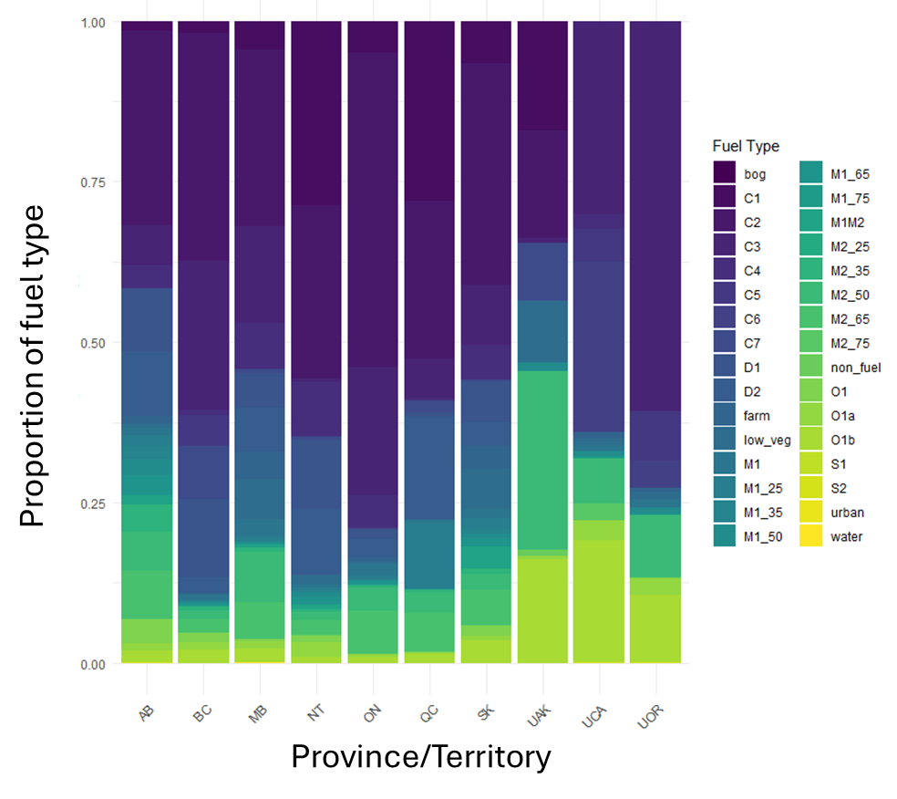
Why is BC having the most wildfires?
Fuel type distribution in 10 provinces
Unique geography and diverse vegetation types
Coniferous forests (C1-C7 fuel types) prevalent in BC

Slide 7
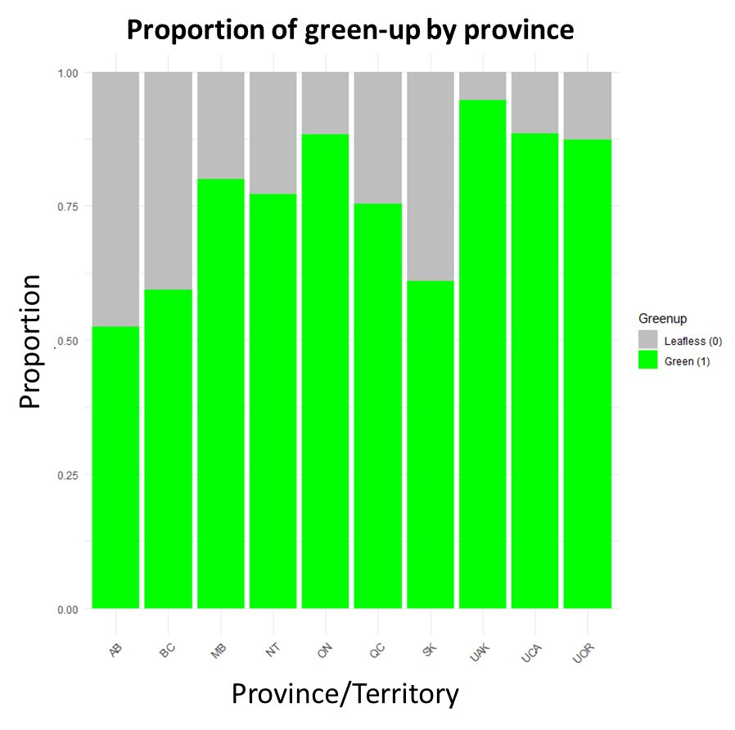
Green/Leafless and Wildfire Risk
Dry branches and stems act as fine fuels, increasing flammability

Slide 8
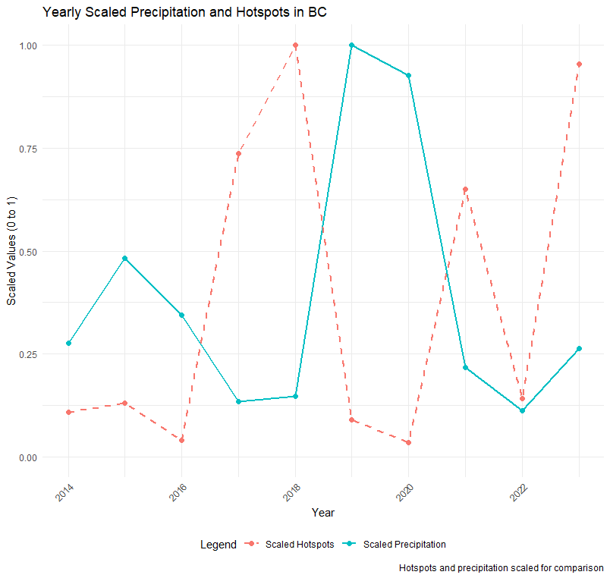
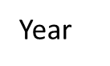
Why BC Struggles to Recover Quickly?
Yearly scaled Precipitation and Hotspots in BC
2017, 2018, 2021-- lowest precipitations → more wildfires
Normalized Precipitation

Slide 9
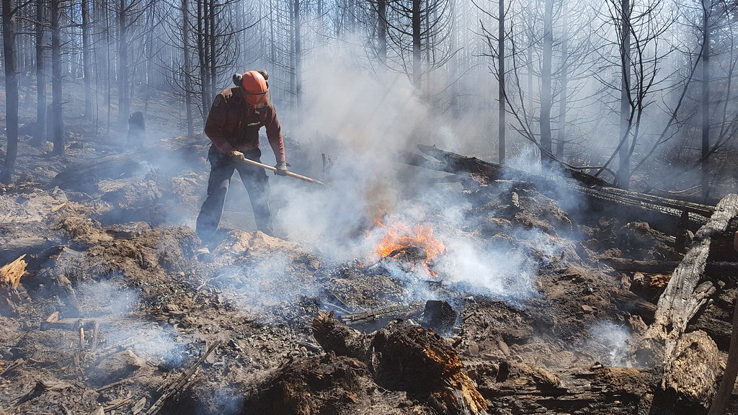
The Solution : Anti-Spray for Wildfires
https://live.staticflickr.com/4904/46155963272_6f1f728743_b.jpg

Slide 10
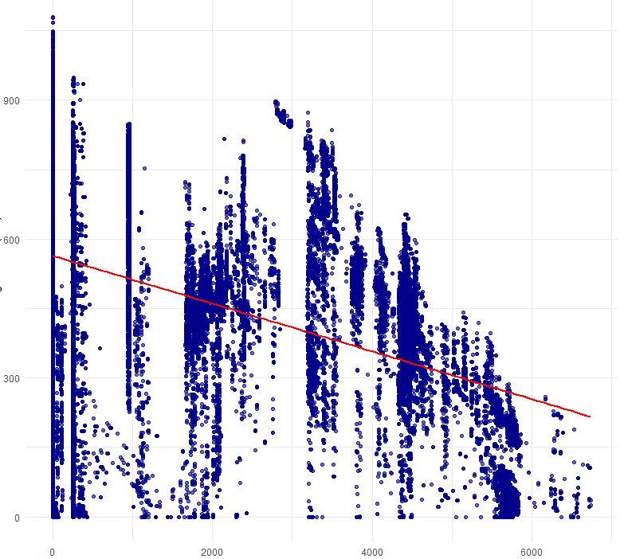
Evidence: Tree Age and DC Correlation
Correlation between Age and Drought Code(DC)
Correlation Coefficient =
-0.4
Older the tree, lower the moisture
Drought Code (DC)
Age of Vegetation (Years)

Slide 11
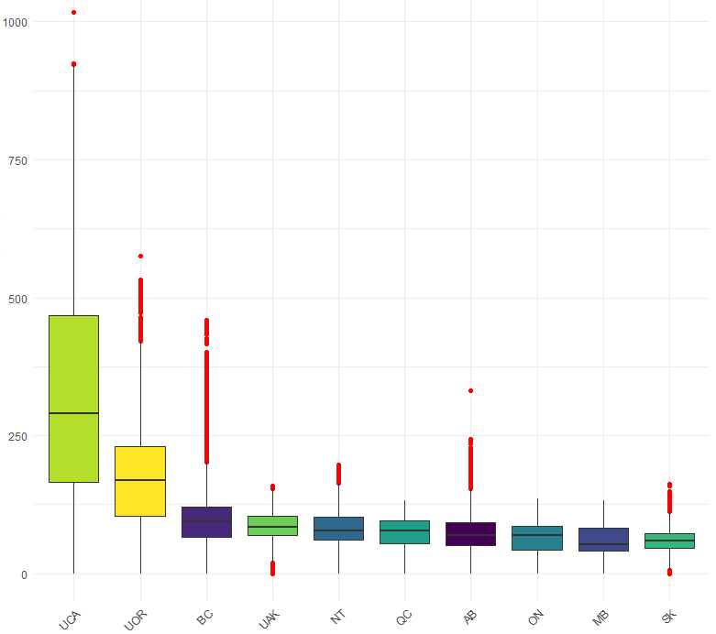
Conclusion
Distribution of Duff Moisture Code(DMC) for Top 10 provinces
High DMC outliers in BC
Introduction of Anti-spray - Mitigate high fire risk
Duff Moisture Code(DMC)
Province/ Territory

Slide 12
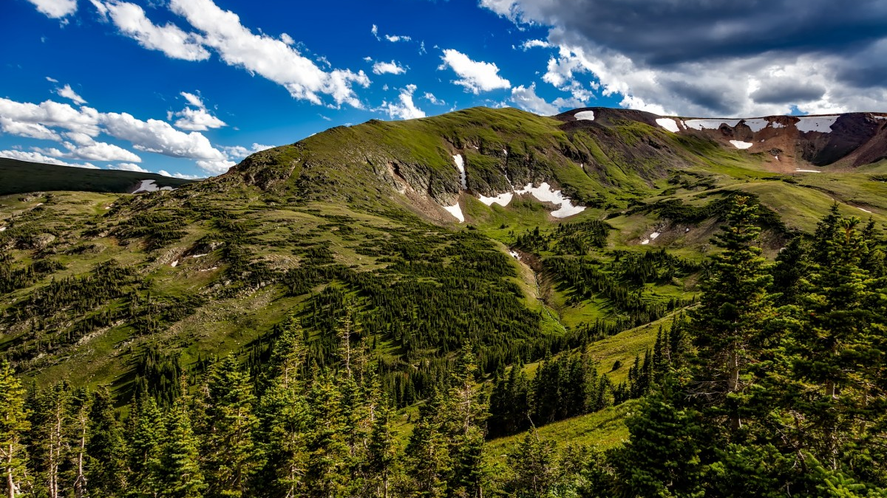
Prevent. Protect. Preserve – Stop Wildfires
Thank You

